Slide 1

Dollars and Cents – How NFL teams spend their money
Jason wattier – Nycdsa web scraping project

Slide 2
Agenda
Domain background – What is the NFL
Project focus – What I wanted to do
Process – What I did
Results - How it all turned out

Slide 3
Domain background
Roster semantics:
Roster Limits
Money Limits
Roster categories
“Put me coach, I’m ready to play” = Active roster
Injured players = Injured reserve
“Gone but still here” players = Dead cap

Slide 4
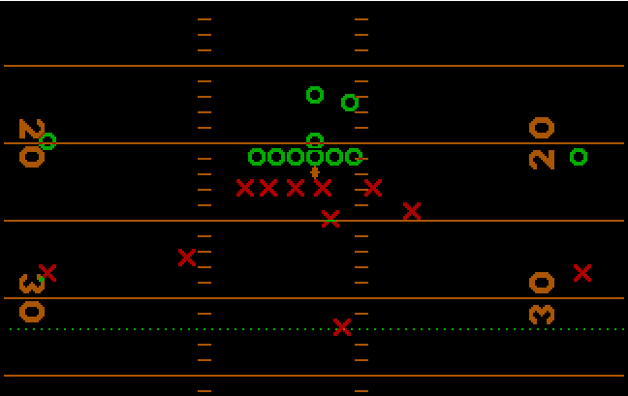
Domain background
Active roster players occupy mutually exclusive positions

Slide 5
Project focus
Is there a relationship between how an NFL team allocates its salary quota and “success”?

Slide 6
Process – Raw Materials
Data analyzed:
NFL team salary at the player level from 2014 to 2019 against season win total
Source: spotrac.com
Contains current and historical salary information for various professional sports leagues in addition to NFL

Slide 7
Process – Making the Soup
Information was aggregated at the team level by year
Salary information was bucketized into five groups:
Active roster (3 groups – offense, defense, specialty)
Injured reserve players (1 group)
Dead cap players (1 group)

Slide 8
Process – Making the Soup (cont.)
Salary information was normalized to relative percentages.
NFL salary limit for a team has increased ~40% from 2014 ($133 million) to 2019 ($188 million)
Increase is due to natural year-to-year inflation of NFL salaries, which are pegged to a percent of league revenues.

Slide 9
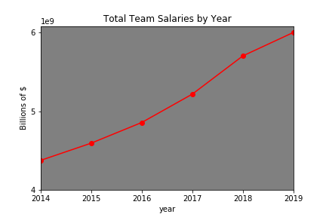
Process – Making the Soup (cont.)

Slide 10
Process – Example Observation
Year-Team | Offense % | Defense % | Specialty % | Injured % | Dead Cap % | Wins
2019_san-francisco-49ers | 33.0% | 34.8% | 2.5% | 18.0% | 11.7% | 13
2019_kansas-city-chiefs | 48.7% | 29.7% | 3.2% | 6.4% | 12.1% | 12
2019_washington-redskins | 20.5% | 21.5% | 3.6% | 46.6% | 7.7% | 3
2019_cincinnati-bengals | 42.7% | 27.0% | 3.1% | 19.5% | 7.7% | 2

Slide 11
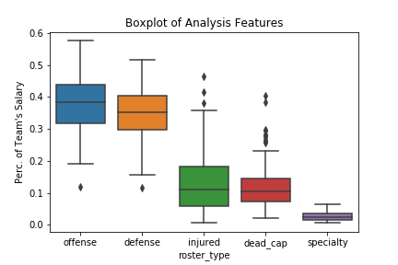
Results – Distribution of Features

Slide 12
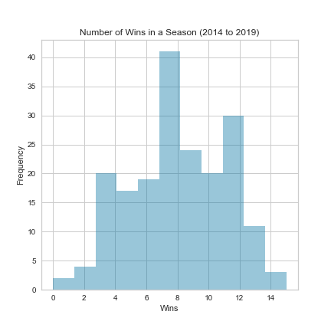
Results – Distribution of Wins

Slide 13
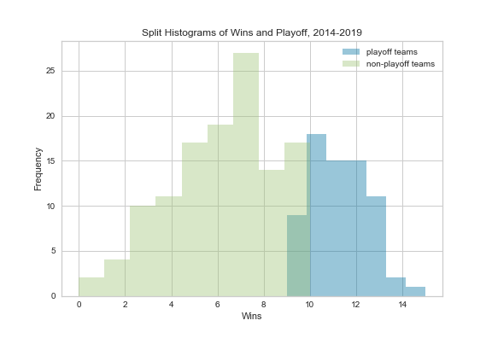
Results – Split Histogram of Wins

Slide 14
Results –Linear Regression
Interpretation of Coefficients:
A ten percent increase in the money associated with players that are injured and not on the active roster is associated with one and a half fewer wins.
A lower p-value represents a more significant result. The general threshold for significance in statistics is a p-value lower than 5 percent (<.05).
Ordinary Least Squares Regression Results
R2 | 0.307
Adj. R2 | 0.292
Feature | Coefficient | T | p-value
Dead Cap | -10.97 | -3.462 | 0.001
Injured | -15.00 | -5.219 | 0.000
Offense | 1.74 | 0.561 | 0.575
Specialty | 22.63 | 0.165 | 0.165

Slide 15
Results –Linear Regression (cont.)
Year-Team | Offense % | Defense % | Specialty % | Injured % | Dead Cap % | Wins | Predicated-Wins
2019_san-francisco-49ers | 33.0% | 34.8% | 2.5% | 18.0% | 11.7% | 13 | 7.1
2019_kansas-city-chiefs | 48.7% | 29.7% | 3.2% | 6.4% | 12.1% | 12 | 9.2
2019_washington-redskins | 20.5% | 21.5% | 3.6% | 46.6% | 7.7% | 3 | 3.3
2019_cincinnati-bengals | 42.7% | 27.0% | 3.1% | 19.5% | 7.7% | 2 | 7.6

Slide 16
In Summary
Create contracts that minimize the penalty of early exits
Understand the impact of even a small amount of injuries
Money spent relative to offensive and defensive units does not significantly explain a team’s success in terms of wins

Slide 17
Questions?

